Slide 1
Hack the markets
Marta González - 22/01/2022

Slide 2
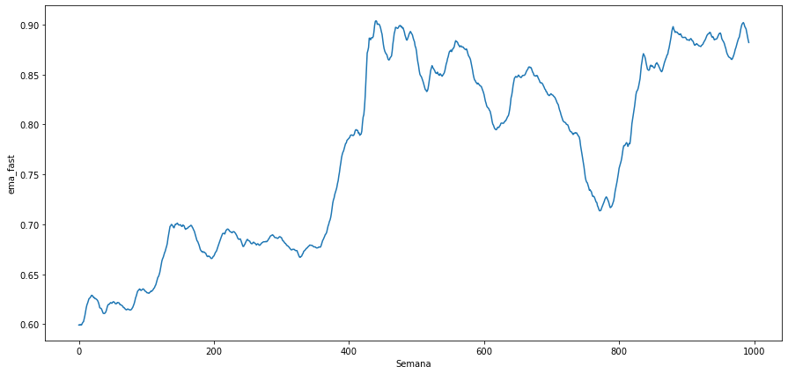
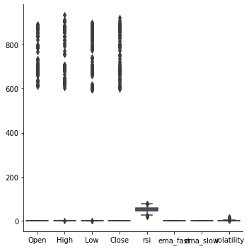

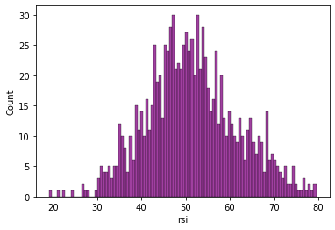
EDA of variables
The values in Open, High, Low and Close have a wide range of values but ema_fast and ema_slow have less variability
RSI index distribution

Slide 3
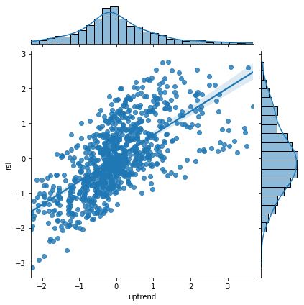
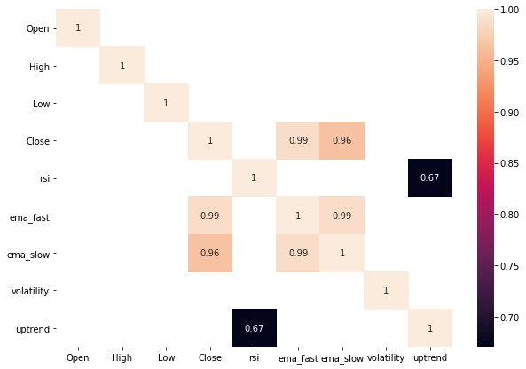
Relation between variables
The rsi and uptrend (new variable=ema_fast-ema_slow) is clear. This means that if forecasting for RSI is growing an uptrend is coming
After standardizing the values we can see relation between the variables that were not obvious

Slide 4
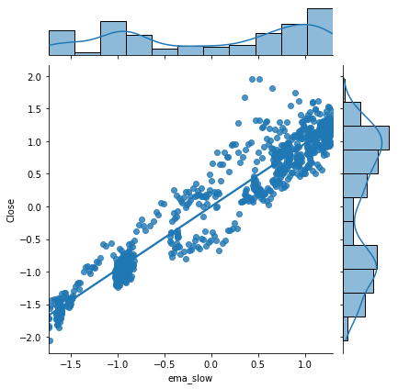
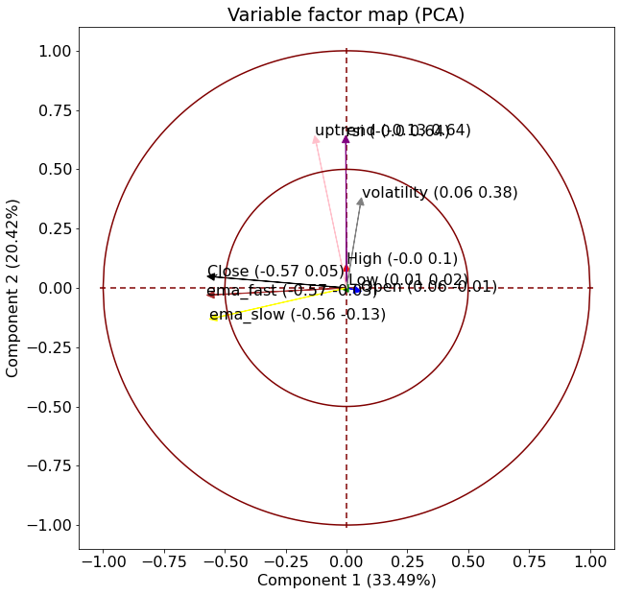
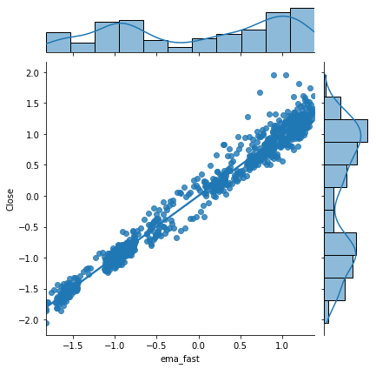
The Close value is correlated to ema_fast and ema_slow. This correlation does not happen with the rest of values Open, High and Low so we can conclude that the most relevant feature for knowing the ema_fast, ema_slow and uptrend is the Closing value of the market.
Using a PCA analysis we can confirm this.

Slide 5
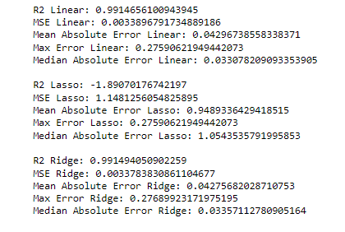
Regression
Regression is used to get a model that can predict the Close value using only the features: ema_fast, ema_slow, volatility and uptrend. The metrics can be seen below

